Slide 1


AGE 219: Variables, Constants,
and Data Types
The Building Blocks of Digital Engineering Logic
Dr. Kadeghe Fue, PhD, P.Eng (T)
AI & Robotics Specialist | Office: EPAL | SoET SUA

Slide 2
Recap of Lecture 1
Yesterday, we explored the foundations of computing, the IPO model, and initialized our Google Colab environment.

Slide 3



What are Variables?
The Digital Mailbox
The Assignment Operator
A variable is a named storage location in your computer's RAM. Think of it as a "labeled box" where you can store data and change it later.
In Python, we use the equals sign (=) to store a value in a variable.
In engineering, we use variables to store sensor readings, GPS coordinates, and equipment IDs.

Slide 4

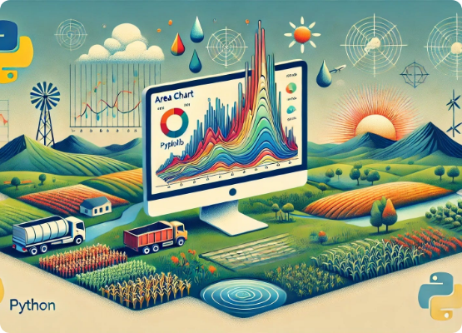
Variable Naming Conventions
Python follows the PEP 8 standard. For engineers, readable code is safer code.
Use snake_case (all lowercase, underscores).
Must start with a letter or underscore.
Cannot start with a number.
Cannot use Python keywords (e.g., print, if, for).

Slide 5








Basic Data Types
Integers (int)
Floats (float)
Strings (str)
Booleans (bool)
Numbers with decimal points. Sensor measurements.
Textual data wrapped in quotes. Labels and IDs.
Whole numbers without decimals. Counts of equipment.
True or False values. Machine status logic.

Slide 6

Integers in Engineering
Discrete Counts
We use integers (int) when the data represents discrete units that cannot be subdivided.
•
Number of tractors in a fleet: 12
•
Active irrigation valves: 8
•
Sensor ID: 1001

Slide 7

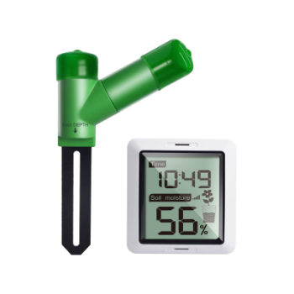
Floating Point Numbers
Continuous Precision
Floating-point numbers (float) represent continuous variables. In agricultural engineering, most sensor data are floats.
Examples: Soil moisture percentage (24.8%), Fuel flow rate (1.25 L/h), Fertilizer application (150.2 kg/ha).

Slide 8

Text and Metadata: Strings
Strings (str) store sequences of characters. They are defined using single (' ') or double (" ") quotes.
Usernames: "fue_kadeghe"
Block Names: 'SUA_Main_Rice_Block'
File Paths: "/data/logs/temp.csv"
String Concatenation: Joining two strings using the + sign.

Slide 9


Logic States: Booleans
Binary States
Machine Logic Examples
Named after George Boole, bool variables can only be True or False.
pump_is_active = True
tank_is_low = False
This is the foundation of all machine decision making and control loops.
is_raining = True

Slide 10

Engineering Constants
Values that remain fixed throughout a physical simulation.

Slide 11
Common Engineering Constants
In Python, we name constants in ALL_CAPS to signal they should not be changed.
Constant Name | Symbol | Standard Value | Python Representation
Gravity (m/s²) | g | 9.81 | GRAVITY = 9.81
Pi | π | 3.14159 | PI = 3.14159
Gas Constant | R | 8.314 | GAS_CONSTANT = 8.314
Zero Celsius in K | - | 273.15 | ZERO_C_IN_K = 273.15

Slide 12

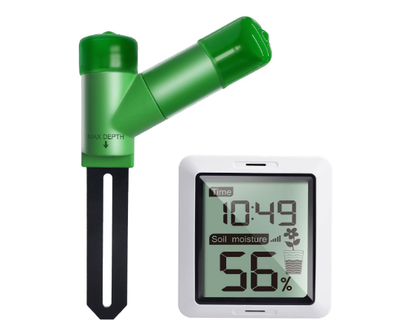

Type Casting
Converting Data Types
Sometimes we need to convert one type to another. This is crucial when processing user inputs, which Python always reads as strings.
int(): Convert to integer.
float(): Convert to float.
str(): Convert to string.

Slide 13
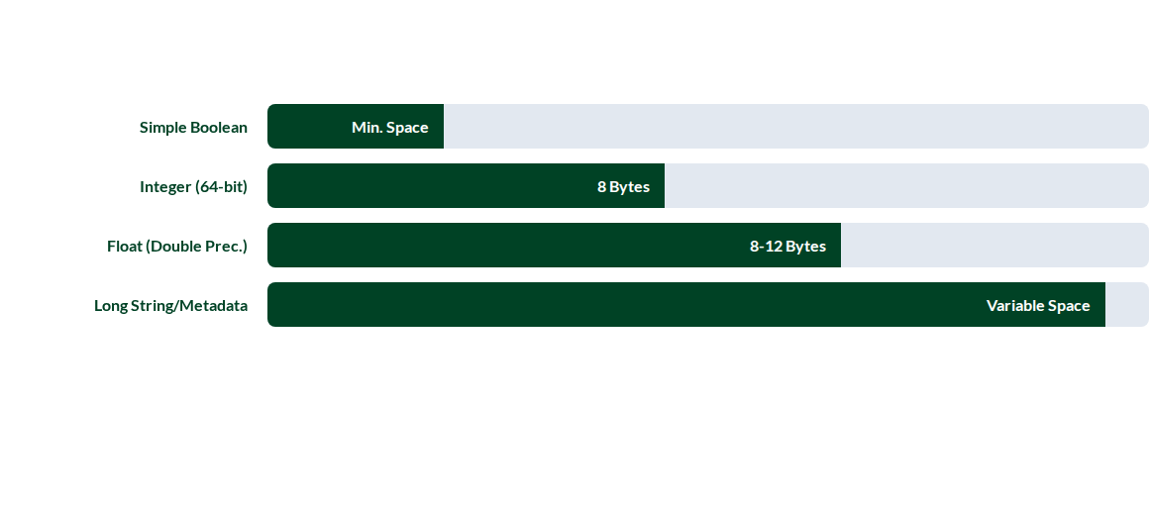
Memory Overhead (Conceptual)
Choosing the correct data type ensures your engineering application remains efficient and prevents memory-related errors in high-speed systems.

Slide 14
Arithmetic Operators
Combining variables using mathematical rules:
Addition (+): Totaling crop yields.
Modulo (%): Remainder of division.
Subtraction (-): Deficit calculation.
Floor Division (//): Quotient without remainder.
Multiplication (*): Area x Application Rate.
Exponent (**): Squaring or cubing values.
Division (/): Average calculation.

Slide 15

Case Study: Fertilizer Calculator
Calculating Urea (46% N) bags required for a field:
We will code this in our practical session using variables and operators.

Slide 16


Questions?
Thank you for your attention.
Next Lecture: Control Flow — Logic and Decisions
School of Engineering and Technology (SoET) | SUA

